Slide 1
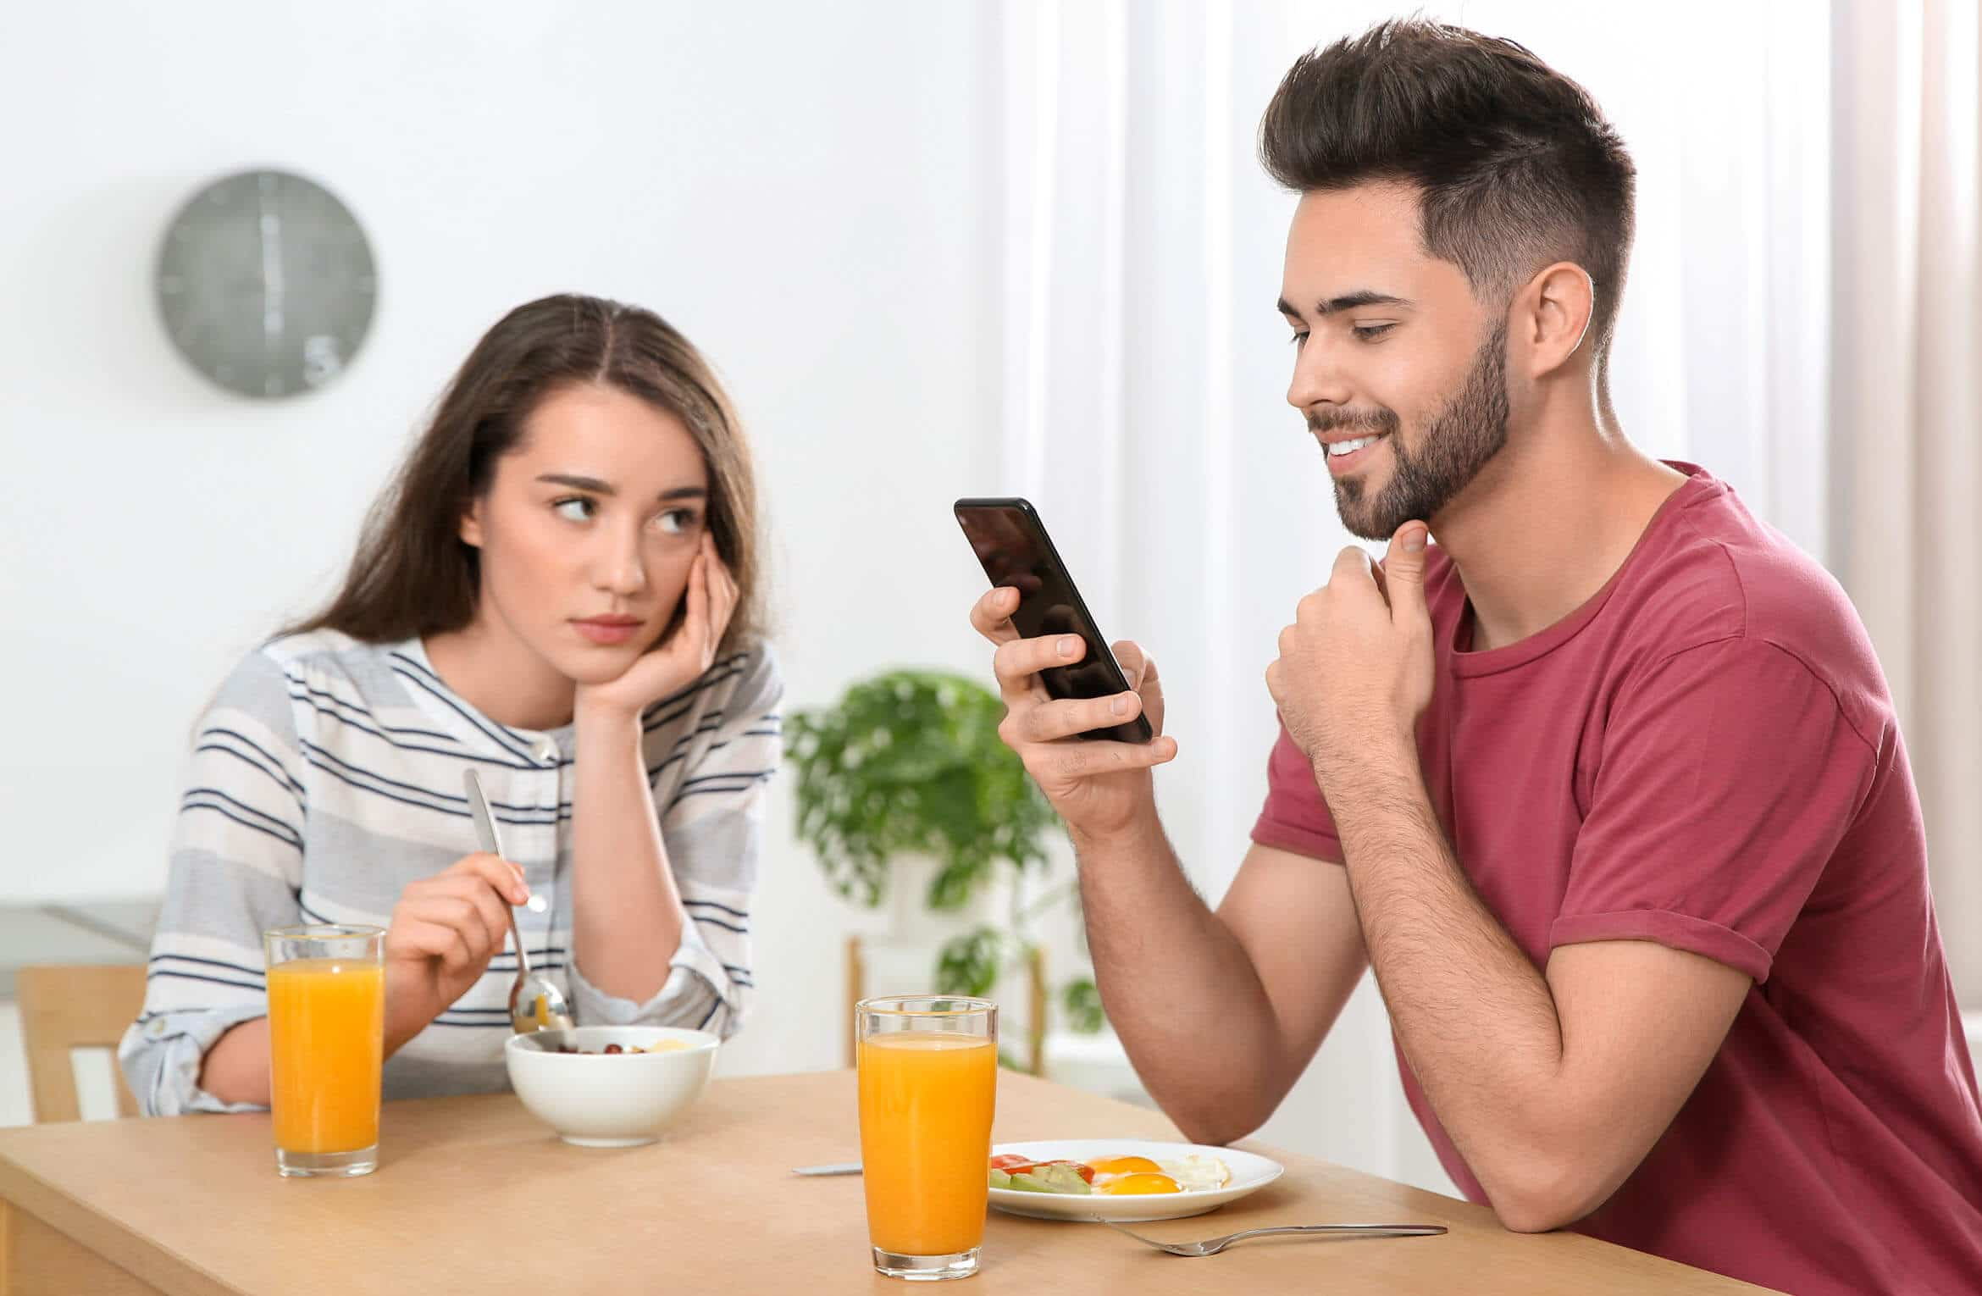
I am so happy to see you again ☺
We lost 3 classes ☹
I’m reminded of last semester
New deadlines

Slide 2
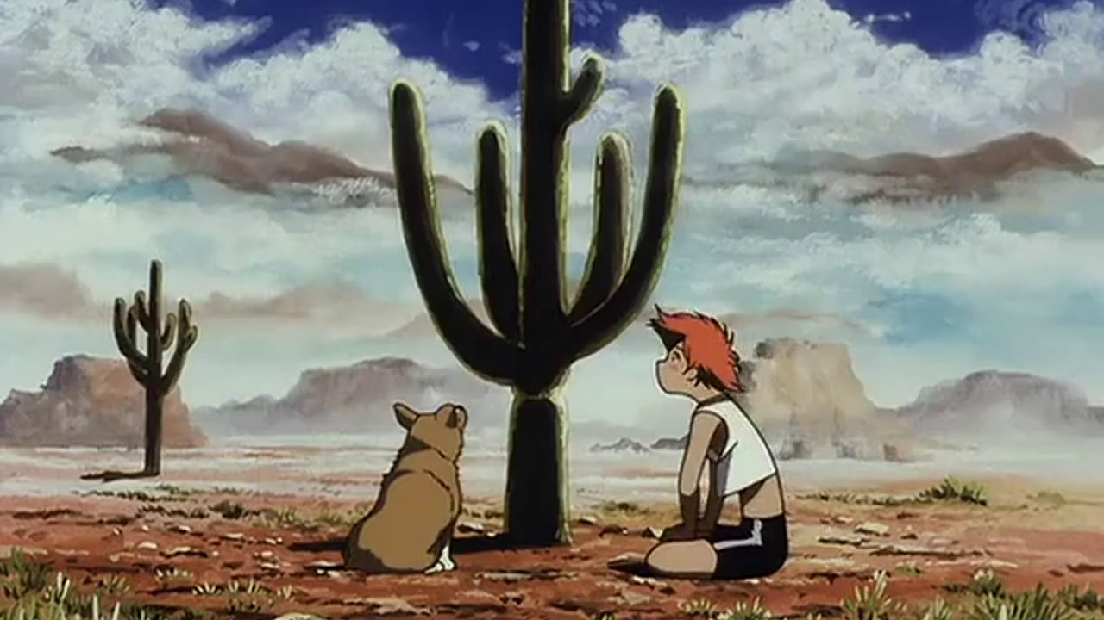
Anyone have a good idea for an app? One sentence

Slide 3
SD + DE
2023
Mobile Applications
Class 2
Daan Nijs

Slide 4
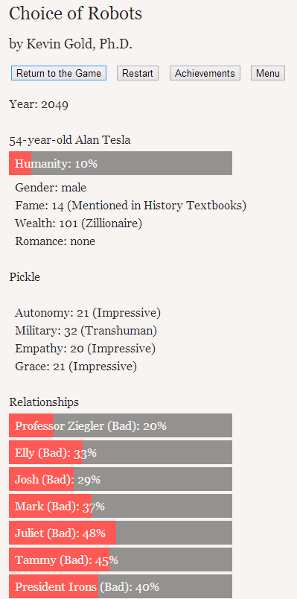
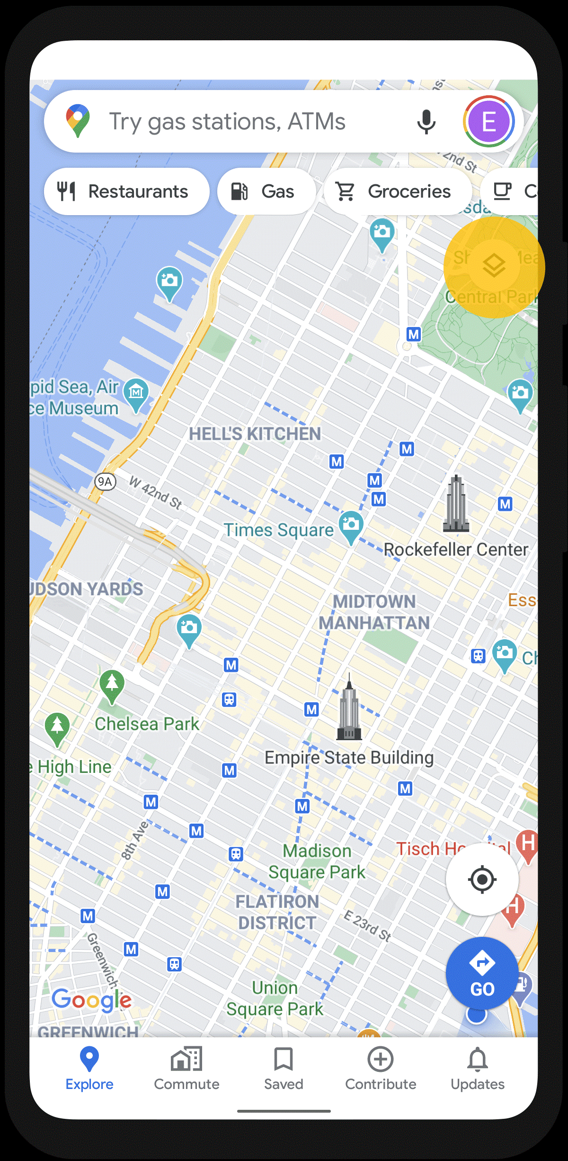
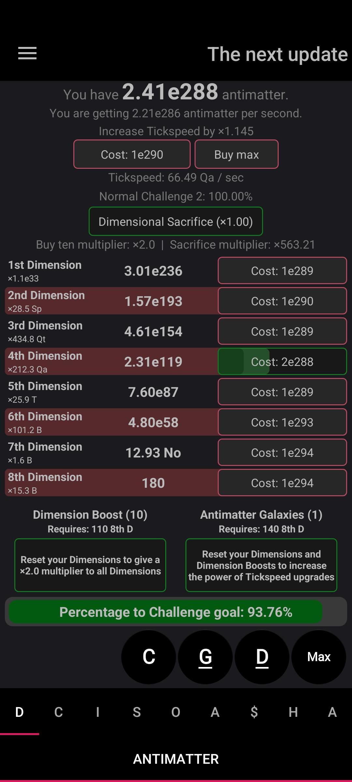
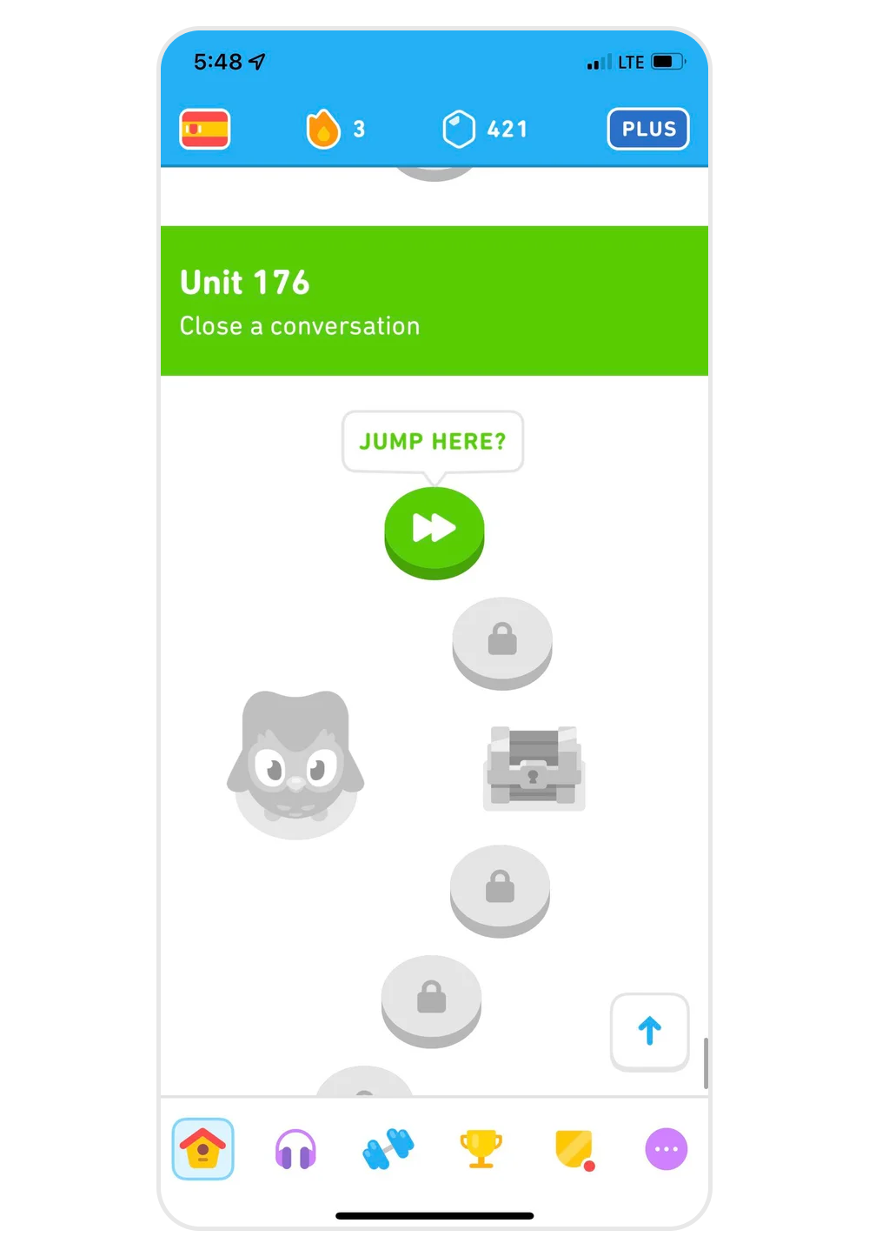
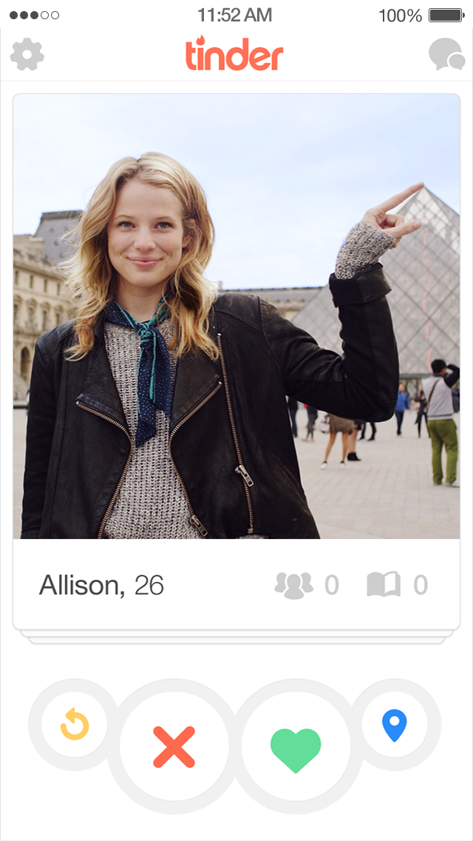
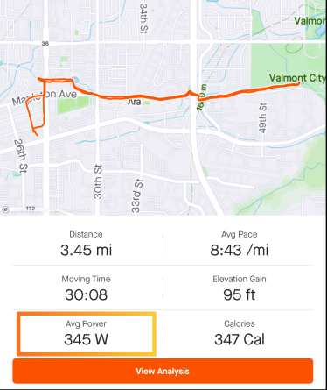
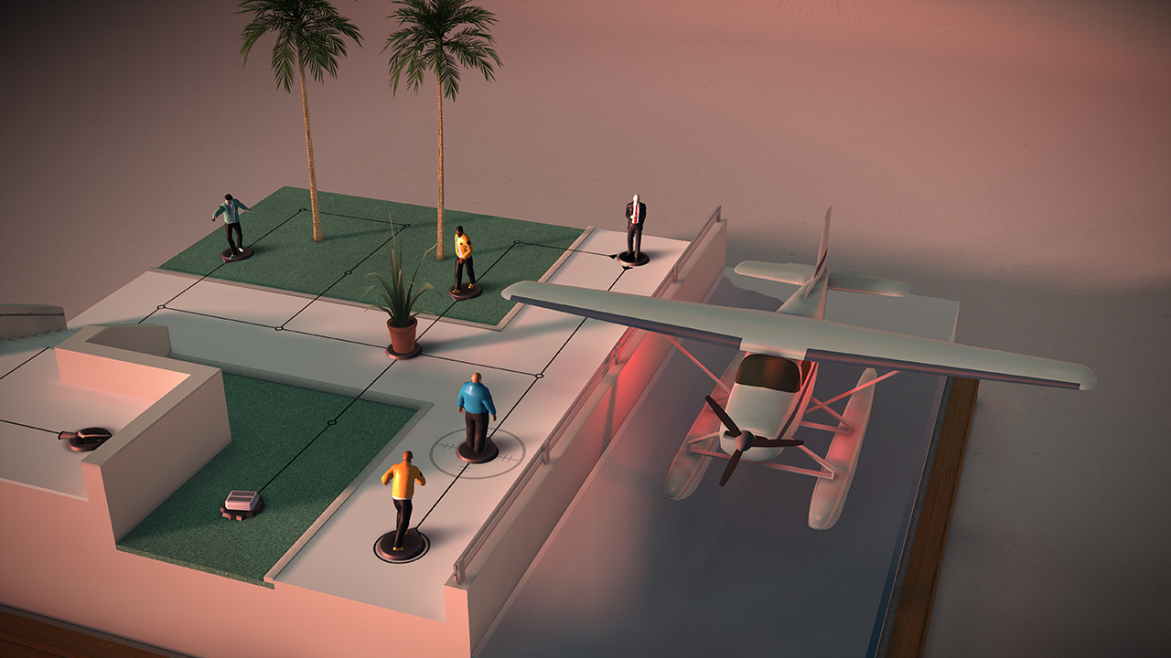

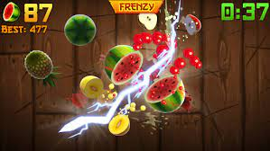
Last class
We look at a lot of mobile games : good / bad / evil

Slide 5
We reasoned about good / bad / evil
Good and bad : important for designing your own app
Evil : just a fun way to think about how developer and user needs can be opposite
Is you’re app allowed to be evil?
Make something you’re proud off
In doubt, just ask

Slide 6
This class
Clarification about evaluation
Clarification about the pitch
Context about mobile applications (history)

Slide 7
Course planning : context
Week 1 No class
Week 2 Introduction, design, pitch
Week 3, 4, 5 🤒
Week 6 : pitch week Monday : → pitch information, tech stack ← Thursday : Emulation, productivity, pitch workshop
Week 7 : No class
Week 7+ : TBD (accessibility, presentation, game dev, requested topics….)

Slide 8
This week
Pitch week!
Tuesday 8pm : online Q&A
Thursday class: emulation, productivity, Unity & react native
Thursday 8pm: deadline for feedback (I will comment on your pitch)
Sunday midnight: deadline for pitch (I will give you a green light or comment on your pitch)

Slide 9
Evaluation
Your pitch : 3 points
Your presentation : 3 points
Your report : evaluated as part of your defense
Your defense : 14 points

Slide 10
Evaluation : Pitch
You get points for the quality of the pitch
How well you following the given requirements of the pitch
You will not be graded on what you’re pitching, but rather how you’re pitching it

Slide 11
What questions do you have?

Slide 12
Good pitch
Example uploaded to Toledo

Slide 13
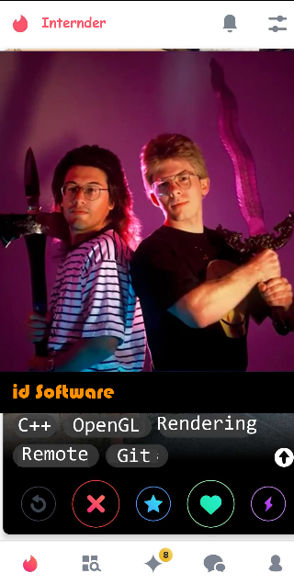
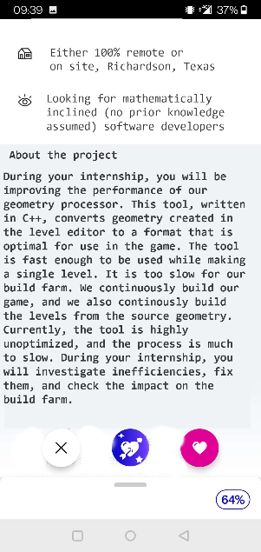
Internder
“Tinder for internships”
Images do a lot of work

Slide 14
Description
Description of your app.
“Sells” your idea.
One or two paragraphs.
Also show why your app is “intrinsically mobile”.

Slide 15
Description
“We would like to pitch an app like Tinder, but for internships. Our current best name is Internder. The profile pictures are replaced with logos of technologies, a picture of the city it is in, the manager, the office, etc... There is no "match", but students can export a list of the internships they're interested in. The idea is a fun way to narrow down the list of potential places to apply for. Currently it’s an Excel file in Toledo that’s inaccessible on mobile. We would like to make this process fun and incremental: swipe on a couple of places while waiting on a bus, maybe a couple of more while waiting in line. Being used in these short moments makes our app intrinsically mobile. At any point the user can export a list of internships they’re interested in so they can make their final choice.”

Slide 16
Motivation
One or two sentences
Explains why you want to make the app
Sells your idea even more
“When we first investigated internships, we were demotivated by how we were supposed to sift through possible places to apply to through a dry excel with unappealing descriptions. It seems logical to make this process fun, so that people are motivated to start internships on day 1.”

Slide 17
Inspiration
Draw comparisons to existing apps (or other things, eg boardgames)
Tries to show that your idea will work

Slide 18
Inspiration
“We looked at tinder a lot for our basic interactions. In tinder, someone swipes left to reject someone, and right to express interest. We do the same: if someone swipes left on an internship, it means they're not interested, and the spot will never be seen again. If someone swipes right, it's added to a list of potentially interesting spots. We chose to do this, as it's proven to be fun, works as a 10-second interaction, and solves the problem of the old excel list being boring.”

Slide 19
Statement of work
List all features you want in your app
Divide between need to have / nice to have
Need to have = minimal viable product = what you need for the app to work
Need to have: ideally doable in half the time
Nice to have: ideally doable in double the time
Ideally you will implement your need to have’s, and some nice to have’s
Time estimation is hard!

Slide 20
Statement of work : Need to have
A local file with all the information (location, id, photo’s, description) of an internship.
A script to transform the existing intranet excel into this local file.
A way to swipe left and right on an internship.
A way to read a description of an internship.
A way to export a list of internships that were swiped right upon.

Slide 21
Statement of work : Nice to have
Automatically update the list of internships from intranet.
Allow photos to be uploaded and viewed.
“Compatibility score” based on a personal profile and tags on internships.
Account for distance in compatibility score.
Allow for chatting with the people offering the internships.
Allow people running the internship to swipe on students. A match is communicated to both parties.

Slide 22
Tech stack
List the technologies you will use for your need to have
Technologies
Can also speculate for nice to have’s
“We’re going to use React Native to build the app. Transforming the excel will be done using a python script, and we’re going to transform it into a json file. If we manage to implement “automatically update the list of internships”, we’re going to query intranet on app startup. If it fails, we’ll use the old file.”

Slide 23
Risks
A list of thigs that could go wrong
“We have never used React Native before.”
“We want to use pictures, but there are none in the database.”

Slide 24
Does anybody know the reason it’s so specific?
Think about your final report

Slide 25
Estimations are hard
I’m betting most of you will spend your time somewhere different than you think
I’m betting most of what will go wrong will not be in your risk section

Slide 26
Code is expensive
It’s easier to think about your app by having to write about it, than to code it
Anticipate problems before having them

Slide 27
What questions do you have?

Slide 28
What was the first smartphone?

Slide 29
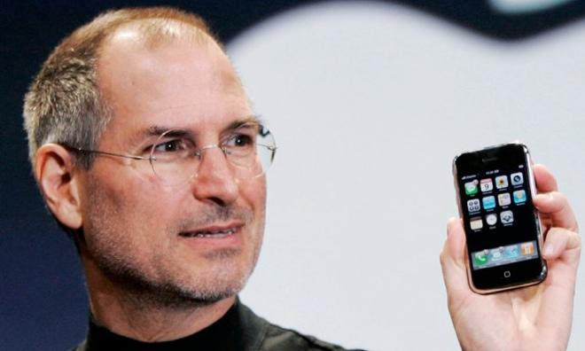
January 9, 2007 : iPhone

Slide 30
Solved the “gorilla arm” problem
By not solving it

Slide 31
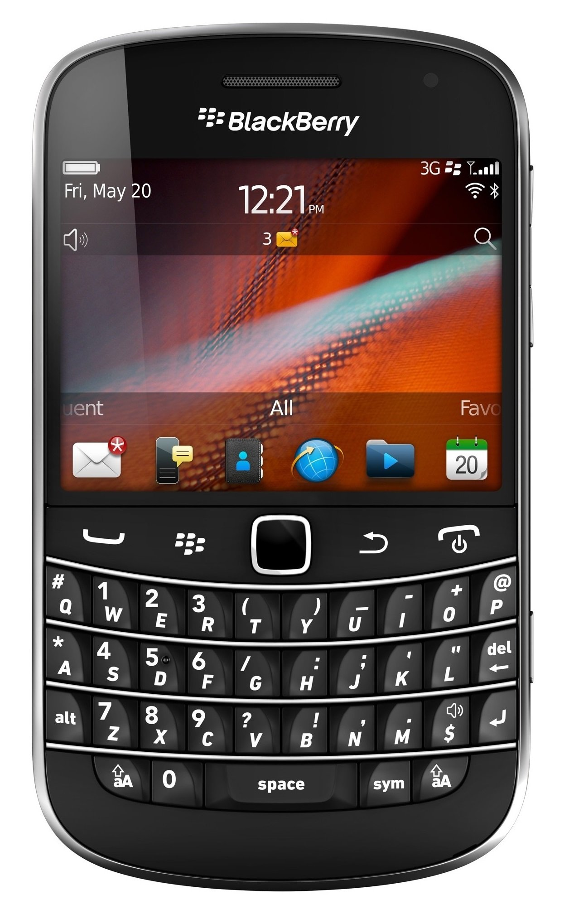
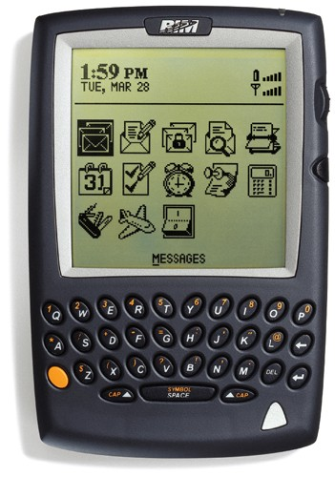
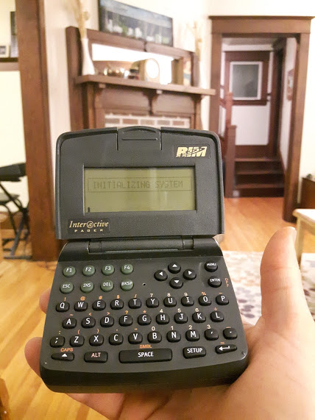
1996 : Blackberry

Slide 32
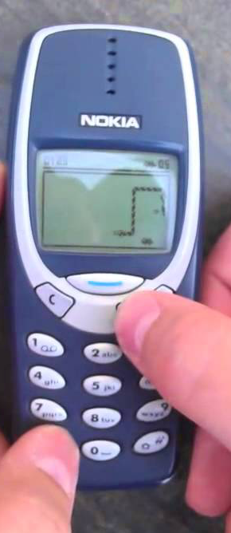
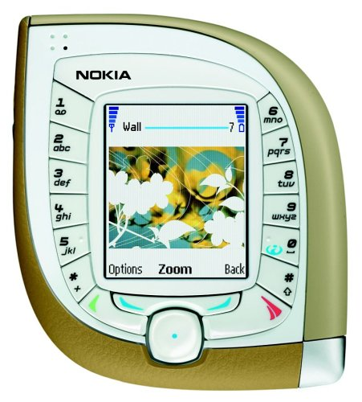
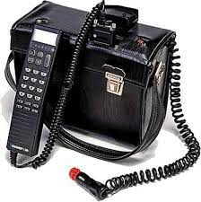
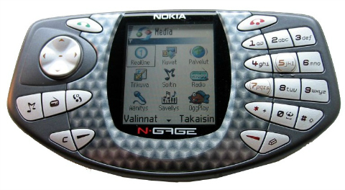
1982 : Nokia

Slide 33
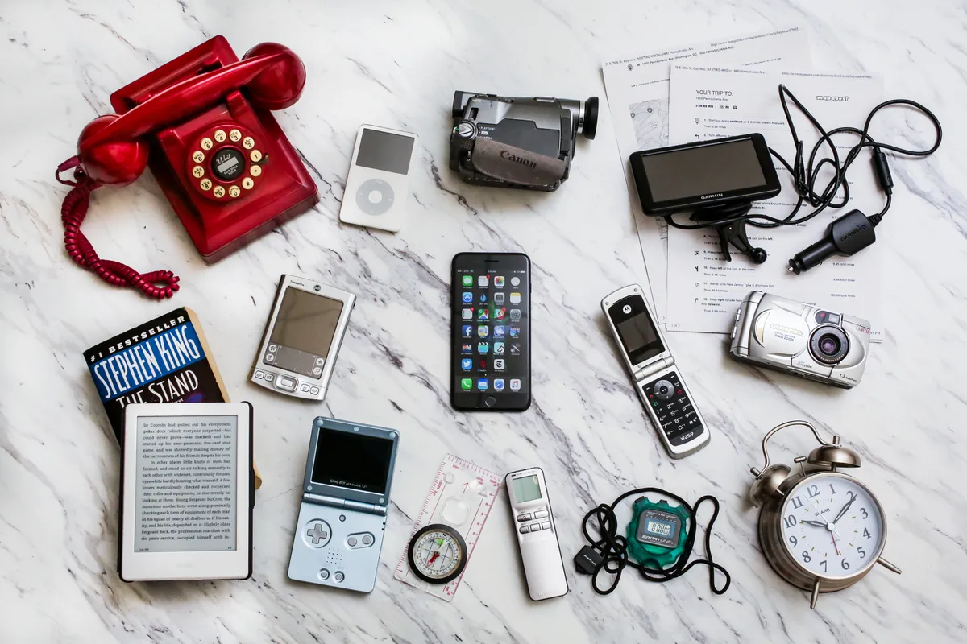
Where do we draw the line for mobile applications?
Good question ☺
Anyone here that doesn’t have a smartphone?
Everyone else : think about what your could do
There’s a lot of “stuff” in your phone

Slide 34

Bounden
Good Bad Evil

Slide 35
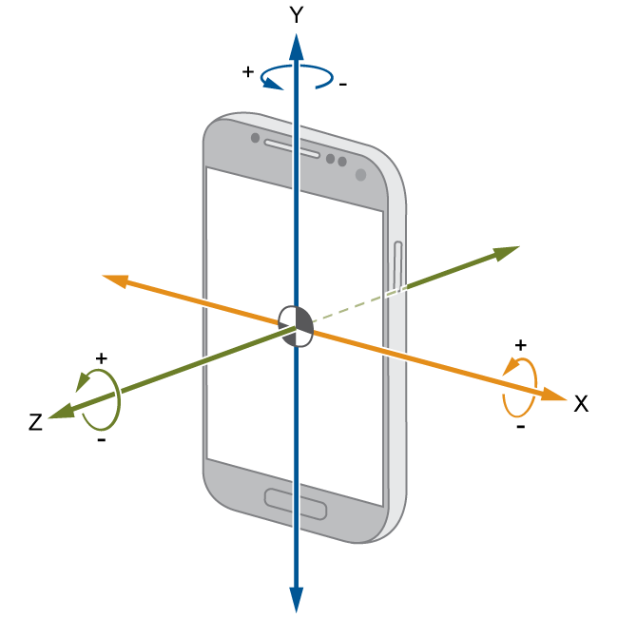
Gyroscope
Allows rotation of device to be known

Slide 36

Be my eyes
Good Bad Evil

Slide 37
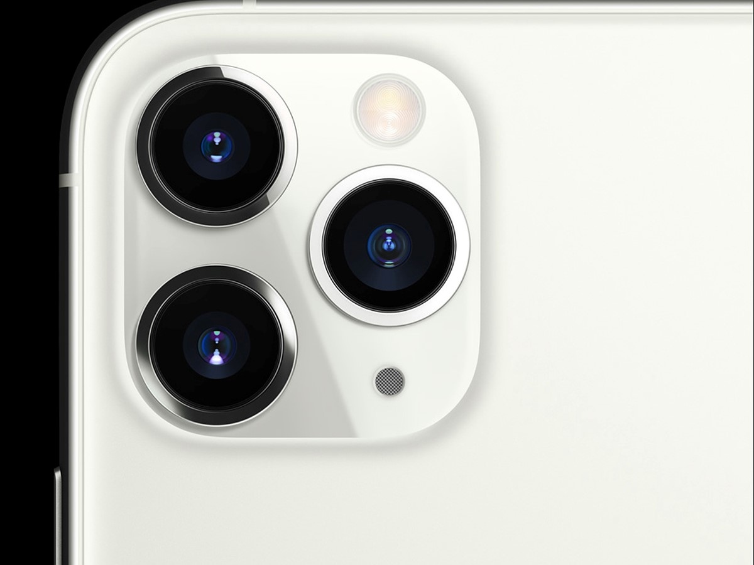
Camera
Incredibly good quality photo’s and videos nowadays
And a decent GPU (graphics card) to process it
And bandwidth to stream
Not just color, also depth

Slide 38
What are your questions?

